Slide 1
Report on Healthcare Survey pertaining to Medical Analysis
By
Gopalakrishnan Kumar, IIT-B Alumnus,
Freelance Data Science Consultant.
LinkedIn URL – https://www.linkedin.com/in/gopalakrishnan-kumar-a73301110/
Git Repository https://github.com/Gopalakrishnan-Kumar/Python-for-Data-Science
Website/blog URL https://www.kaggle.com/gopalkk1

Slide 2
Google Colab URL
https://colab.research.google.com/drive/1Y7w0ndbf4AbNdfnaW3BwCADA3Kg7qopt
This is a Classification Problem, dealing with Test Results…
The above is the Google Colab Notebook for the Report..

Slide 3
Data Source
This dataset contains the following columns:
Name
Age
Gender
Blood Type
Medical Condition
Date of Admission
Doctor
Hospital
Insurance Provider
Billing Amount
Room Number
Admission Type
Discharge Date
Medication Test Results

Slide 4
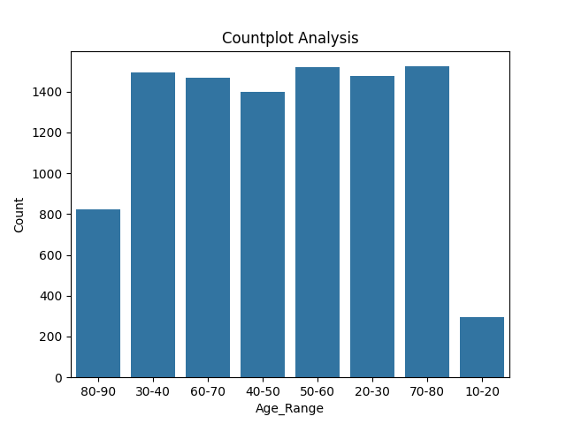
Countplot of Age
This graph explains frequency of Age Range variable..

Slide 5
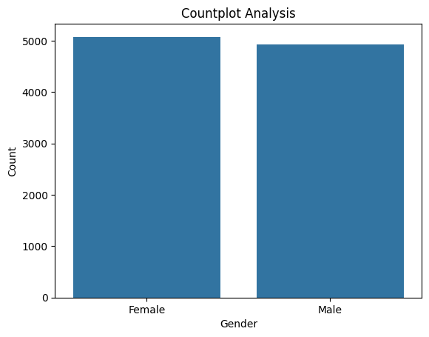
Countplot of Gender
This graph explains frequency of Gender variable..

Slide 6
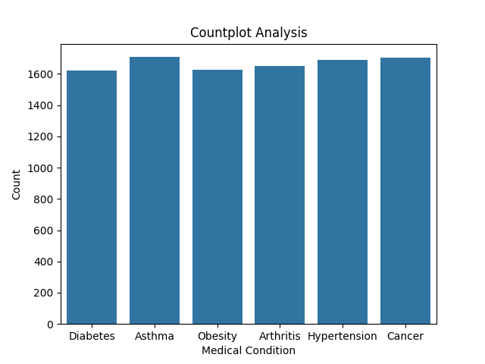
Countplot of Blood Type
This graph explains frequency of Blood Type variable..

Slide 7
Countplot of Medical Condition
This graph explains frequency of Medical Condition variable..

Slide 8
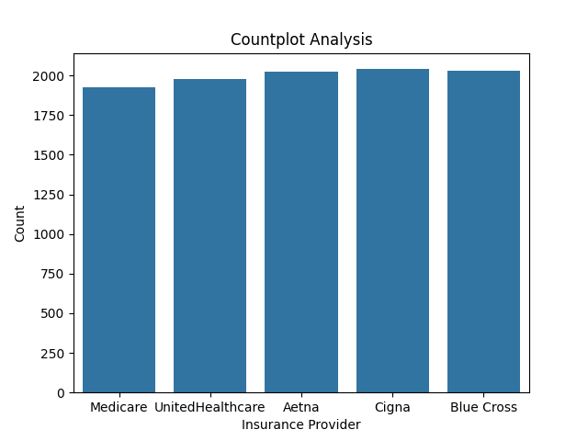
Countplot of Insurance Provider
This graph explains frequency of Insurance Provider variable..

Slide 9
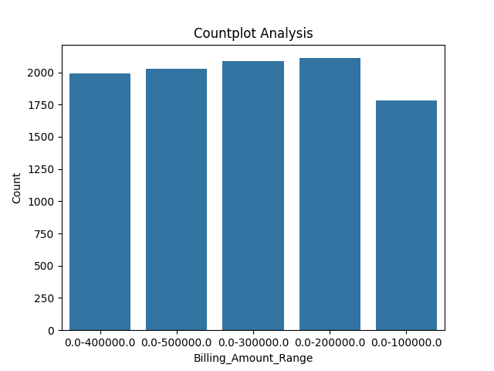
Countplot of Billing Amount
This graph explains frequency of Billing_Amount_Range variable..

Slide 10
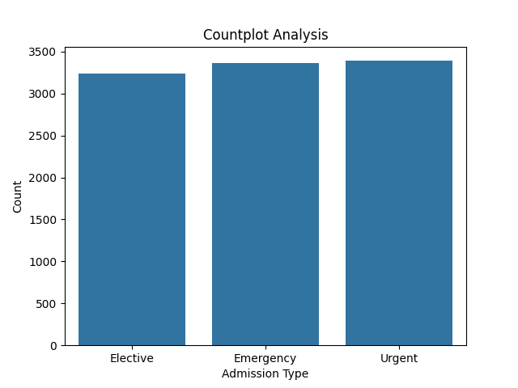
Countplot of Admission Type
This graph explains frequency of Admission Type variable..

Slide 11
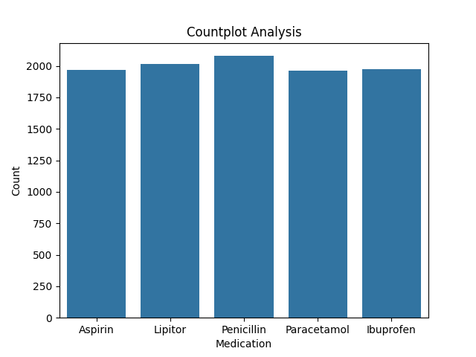
Countplot of Medication
This graph explains frequency of Medication variable..

Slide 12

Countplot of Test Results
This graph explains frequency of Test Results variable..

Slide 13
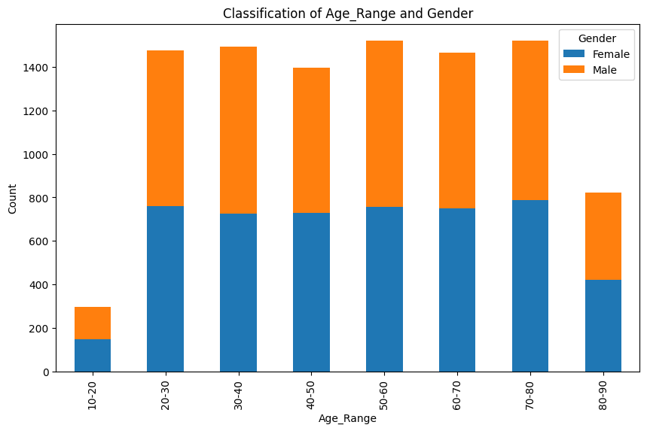
Classification of Age and Gender
This graph explains Classification between Age and Gender..

Slide 14
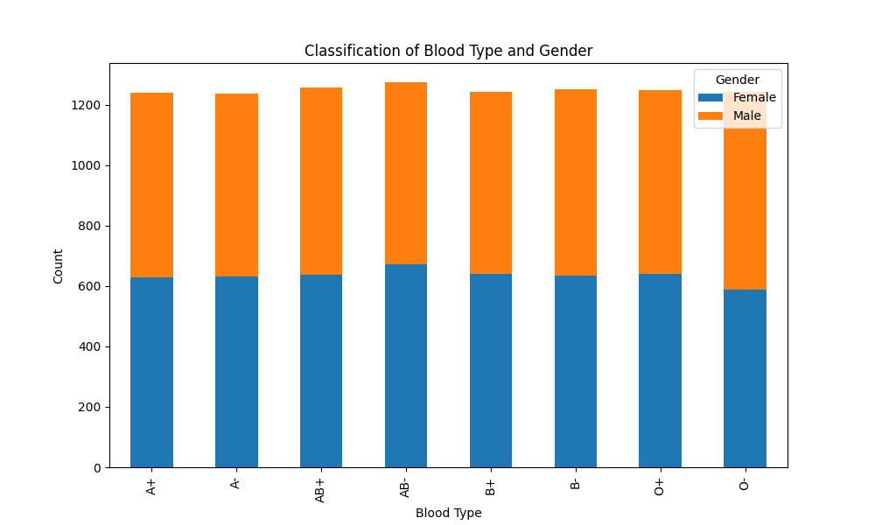
Classification of Blood Type and Gender
This graph explains Classification between Blood Type and Gender..

Slide 15
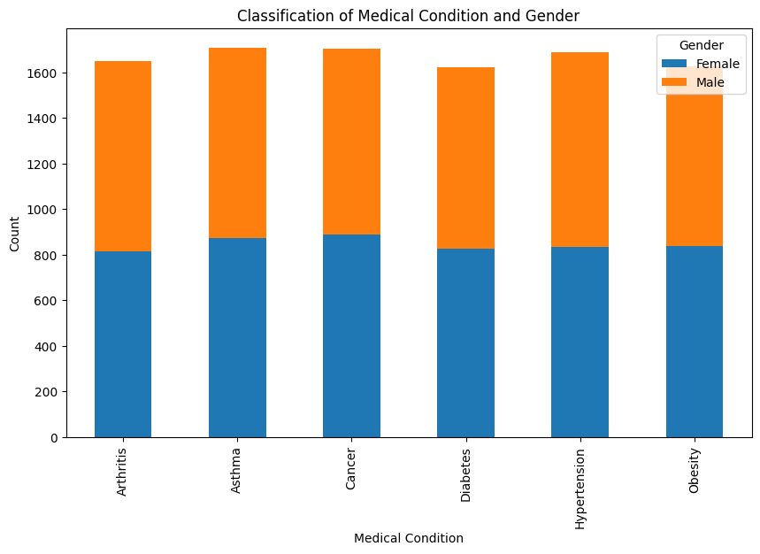
Classification of Medical Condition and Gender
This graph explains Classification between Medical Condition and Gender..

Slide 16
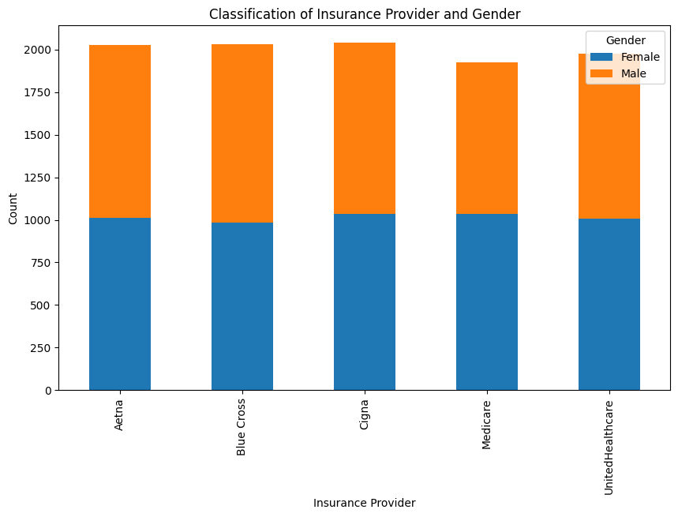
Classification of Insurance Provider
This graph explains Classification between Insurance Provider and Gender..

Slide 17
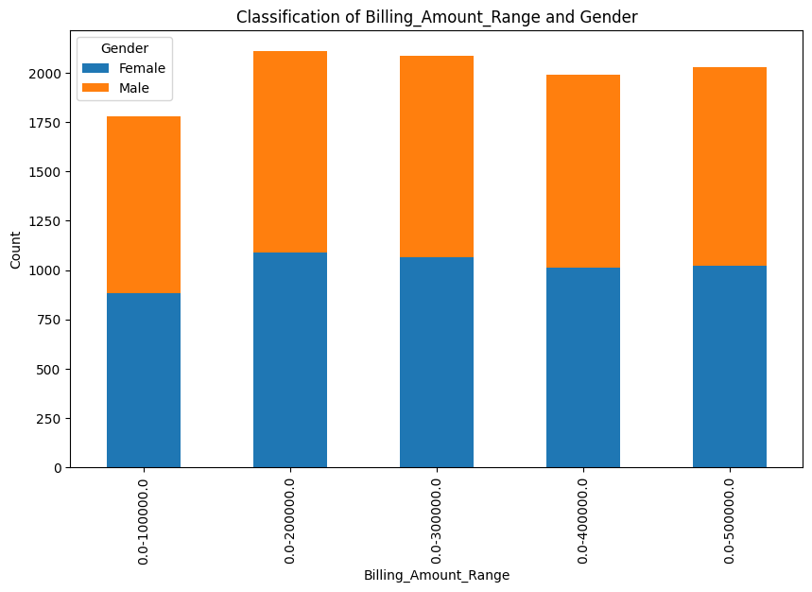
Classification of Billing Amount and Gender
This graph explains Classification between Billing Amount and Gender..

Slide 18
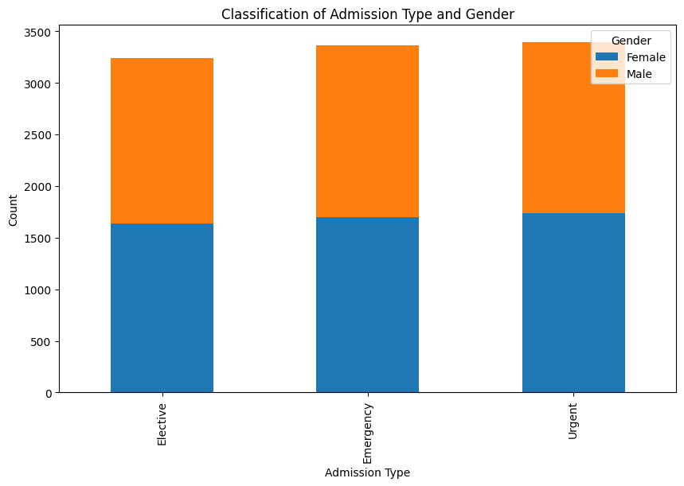
Classification of Admission Type and Gender
This graph explains Classification between Admission Type and Gender..

Slide 19
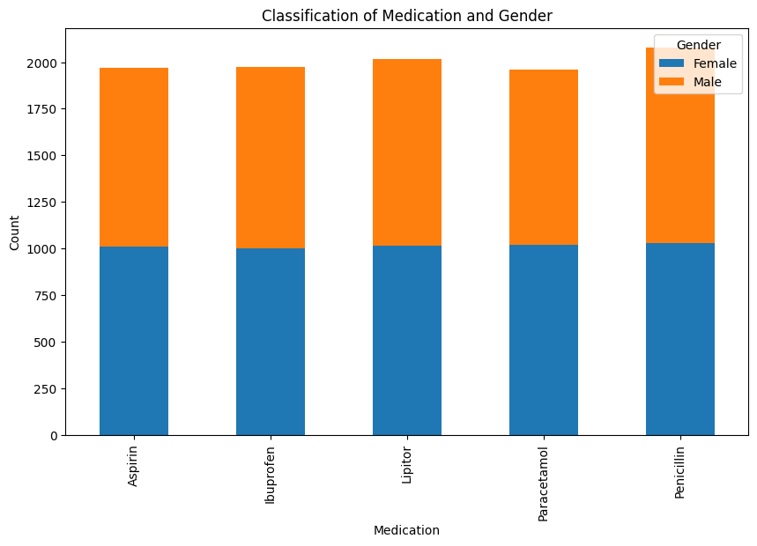
Classification of Medication
This graph explains Classification between Medication and Gender..

Slide 20
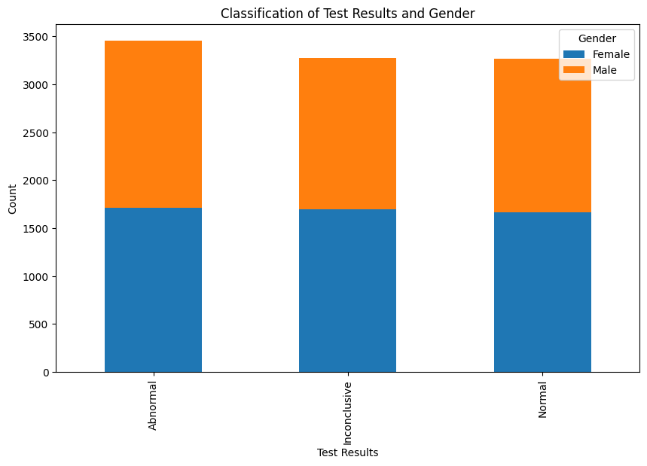
Classification of Test Results
This graph explains Classification between Medication and Gender..

Slide 21
Classification Report
Accuracy: 1.0
precision recall f1-score support
0 1.00 1.00 1.00 706
1 1.00 1.00 1.00 636
2 1.00 1.00 1.00 658
accuracy 1.00 2000
macro avg 1.00 1.00 1.00 2000
weighted avg 1.00 1.00 1.00 2000
This is a Classification Report…for the dataset…

Slide 22
Random Forest
Random Forest Accuracy: 1.0
Random Forest Classification Report:
precision recall f1-score support
0 1.00 1.00 1.00 706
1 1.00 1.00 1.00 636
2 1.00 1.00 1.00 658
accuracy 1.00 2000
macro avg 1.00 1.00 1.00 2000
weighted avg 1.00 1.00 1.00 2000
This is a Random Forest Report…

Slide 23
Decision Tree
Decision Tree Accuracy: 1.0
Decision Tree Classification Report:
precision recall f1-score support
0 1.00 1.00 1.00 706
1 1.00 1.00 1.00 636
2 1.00 1.00 1.00 658
accuracy 1.00 2000
macro avg 1.00 1.00 1.00 2000
weighted avg 1.00 1.00 1.00 2000
This is a Decision Tree Report…

Slide 24
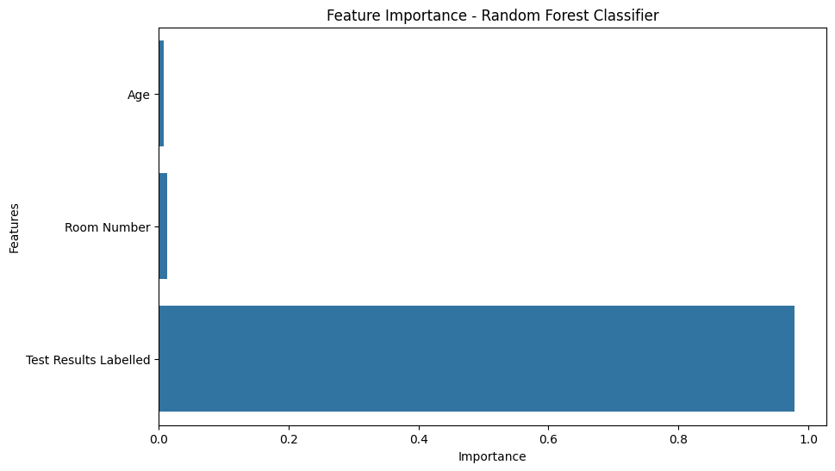
Feature Importance- Random Forest Classifier
This is a Feature Importance graph based on Random Forest Classifier…

Slide 25
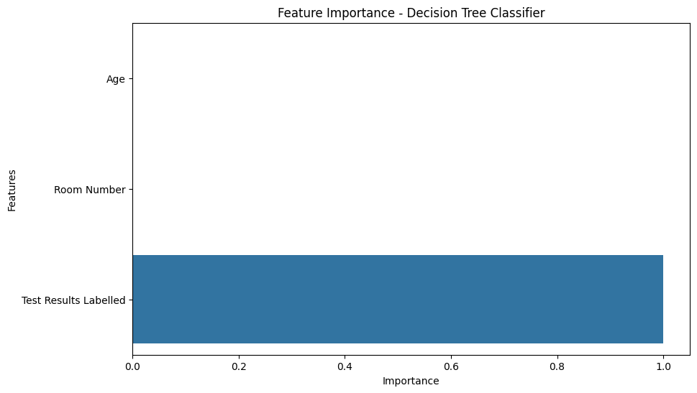
Feature Importance- Decision Tree Classifier
This is a Feature Importance graph based on Decision Tree Classifier…

Slide 26
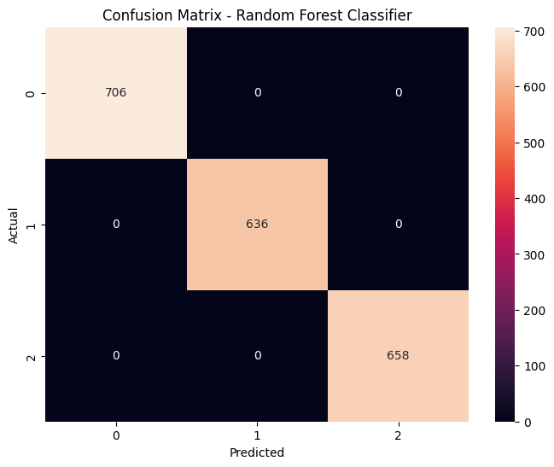
Confusion Matrix- Random Forest Classifier
This is a Confusion Matrix graph based on Random Forest Classifier…

Slide 27

Confusion Matrix- Decision Tree Classifier
This is a Confusion Matrix graph based on Decision Tree Classifier…

Slide 28
Inferences from Data Analysis in Healthcare.csv dataset..
The results are::
-- Accuracy is 1.0/1.0 [Random Forest, Decision Tree]
-- This is 100% accuracy [Classification Report]
-- This dataset is the correct dataset should be analyzed further for data
visualization in equation of plot analysis.. for future studies

Slide 29
Conclusion
As per data analysis this a good dataset…

Slide 30
Thank you
Thank you
Thank you

